Slide 1
Q-GUARD
Quantum-Assisted Financial Fraud Detection
Team Members:
K Sudhakar
E Lathika

Slide 2

Problem Statement:
With the rapid growth of online payments and digital banking, financial fraud has increased significantly. Traditional fraud detection systems are mostly static and rule-based, making them less effective against unpredictable fraud patterns. This creates a need for a smarter and more adaptive fraud detection system capable of analyzing suspicious transactions in real time.
Why Existing System Fails:
Online banking fraud is increasing rapidly Traditional systems use static rule-based detection Fraudsters behave unpredictably Existing systems struggle with adaptive analysis Delayed fraud detection causes financial losses

Slide 3
Proposed Solution:
Q-Guard
“We propose a hybrid fraud detection system that combines Machine Learning and quantum-inspired anomaly analysis. The system first processes transaction data and uses a Random Forest model to detect known fraud patterns. A quantum simulation layer is then used to identify unusual or uncertain transaction behavior. Finally, a hybrid decision engine combines both outputs to generate a final fraud risk prediction, improving accuracy and adaptability compared to traditional systems.”
Key Idea:
Our system:
Analyzes transaction behavior
Detects anomalies using Machine Learning
Uses quantum randomness for adaptive risk scoring
Displays results through an interactive dashboard

Slide 4
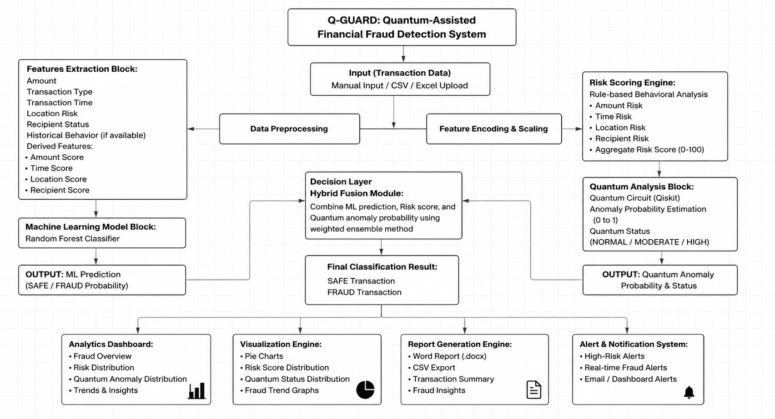
ARCHITECTURE

Slide 5






Technologies Used
Frontend: Streamlit
Programming language : Python
Machine Learning: Scikit learn , Random Forest
Data Preprocessing :Pandas , Numpy
Quantum Computing:QISKIT
Visualization : Plotly , Matplotlib

Slide 6
Quantum Integration
Why We Used Quantum Integration
Traditional fraud systems mainly detect known fraud patterns. Our quantum integration layer helps estimate abnormal transaction behavior using probabilistic analysis.
Quantum Layer Workflow
Transaction Data
↓
Risk Score Generation
↓
Quantum Circuit Encoding
↓
Qiskit Quantum Simulation
↓
Quantum Measurement Outcomes
↓
Anomaly Probability Estimation
↓
Hybrid Fraud Decision

Slide 7
How Our Model Works
Transaction Data
The system receives transaction details such as amount, transaction type, balances, device, and location for fraud analysis.
Data Preprocessing
The dataset is cleaned and prepared by removing missing values and selecting important features for machine learning
Machine Learning Model
A Random Forest model analyzes transaction patterns and learns to identify fraudulent behavior.
The model predicts whether the transaction is safe or fraudulent and generates a fraud probability score.
Behavioral Risk Scoring
Quantum Anamoly Analysis
Qiskit generates quantum randomness to introduce probabilistic uncertainty and slightly adjust risk analysis.
Hybrid Decision Engine
The system generates a dynamic fraud risk percentage based on transaction behavior and model prediction.
Final Fraud Prediction
The final fraud alerts, analytics, graphs, and risk scores are displayed through an interactive dashboard.

Slide 8
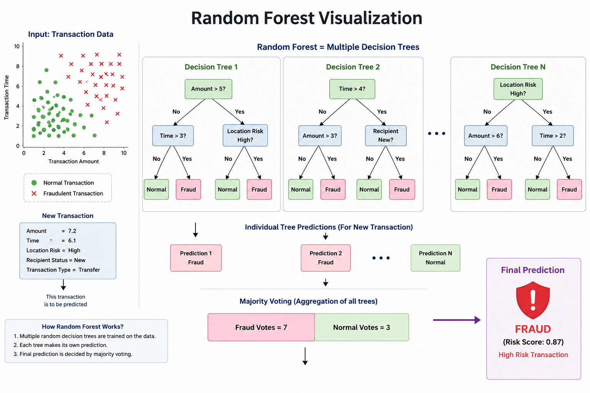
Machine Learning Model
Random Forest Classifier
Why We Used Random Forest
High accuracy for classification problems Handles large datasets efficiently Reduces overfitting Good at detecting fraud patterns and anomalies
How the Model Works
The model is trained using historical transaction data.
It learns the difference between:
normal transactions
fraudulent transactions
Based on transaction behavior, it predicts fraud probability.

Slide 9
Quantum Problem Addressed
Classical ML models rely only on deterministic pattern matching from historical data.
They often fail to represent uncertainty in complex or borderline transactions.
Fraud detection involves a huge probability space, which is difficult for classical systems to fully explore.
Our quantum-inspired layer addresses this by modeling behavioral uncertainty and anomaly probability in a probabilistic way.
It helps identify cases where transactions are not clearly fraud or safe, improving decision refinement.
What was built
Risk scoring system for transactions
Quantum-inspired anomaly detection using Qiskit
Hybrid decision engine for final fraud prediction

Slide 10
Unique Value Proposition
We combine Classical Machine Learning (Random Forest) with a Quantum-Inspired anomaly detection layer for fraud analysis.
Instead of relying only on past patterns, our system also evaluates behavioral uncertainty in transactions.
A dual-layer intelligence system ensures both pattern-based and probability-based fraud detection.
The quantum layer helps detect cases where ML alone may be overconfident or uncertain.
A hybrid decision engine fuses both outputs to improve accuracy and reduce false positives.
This makes the system more adaptive, robust, and future-ready for complex fraud patterns.
Real-World Impact
Helps banks and financial systems detect fraud in real-time transactions.
Reduces false positives, ensuring genuine users are not blocked unnecessarily.
Improves security for online payments, UPI, net banking, and digital wallets.
Enables early detection of unusual or emerging fraud patterns that traditional systems may miss.
Can be integrated into fintech apps and banking APIs to strengthen cybersecurity.
Supports a safer digital economy by increasing user trust and transaction reliability.

Slide 11
Conclusion
We developed a hybrid fraud detection system combining Random Forest machine learning with a quantum-inspired anomaly layer.
The ML model detects known fraud patterns, while the quantum layer evaluates uncertainty and unusual transaction behavior.
By combining both approaches, the system aims to improve fraud detection accuracy and reduce false positives.
Our solution is scalable, future-ready, and applicable to modern digital payment ecosystems.
This project demonstrates how classical AI and quantum-inspired computing can work together for smarter cybersecurity solutions

Slide 12
Thank you

